Slide 1
Database For Data Science Platform
Preetam Balijepalli

Slide 2
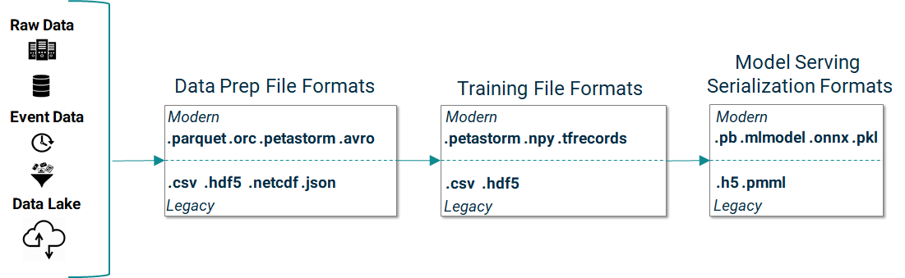
Flow

Slide 3
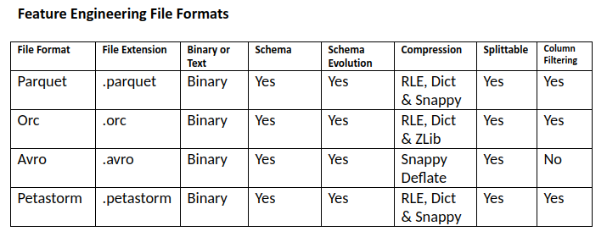
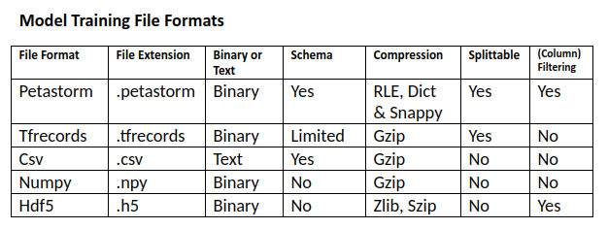
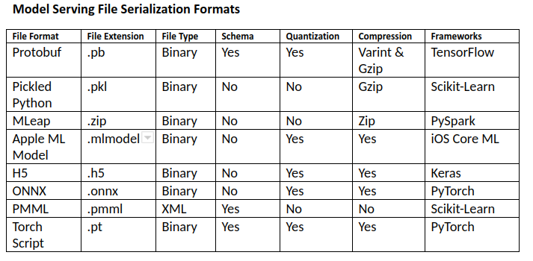
Common used File Formats
Apart from the above there are other well-known file formats
Image file formats (e.g., .png, .jpeg), video file formats (e.g.,.mp4, .mkv, etc)
Archive file formats (e.g.,.zip, .gz, .tar, .bzip2),
Document file formats (e.g., .docx, .pdf, .txt) or web file formats (e.g., .html).

Slide 4
Current Needs
Application level data is any user preferences for example specific model outputs which has been personalized by the user by specifying custom input parameters; comments and annotations;

Slide 5
To Be Defined
To Be Defined

